Slide 1
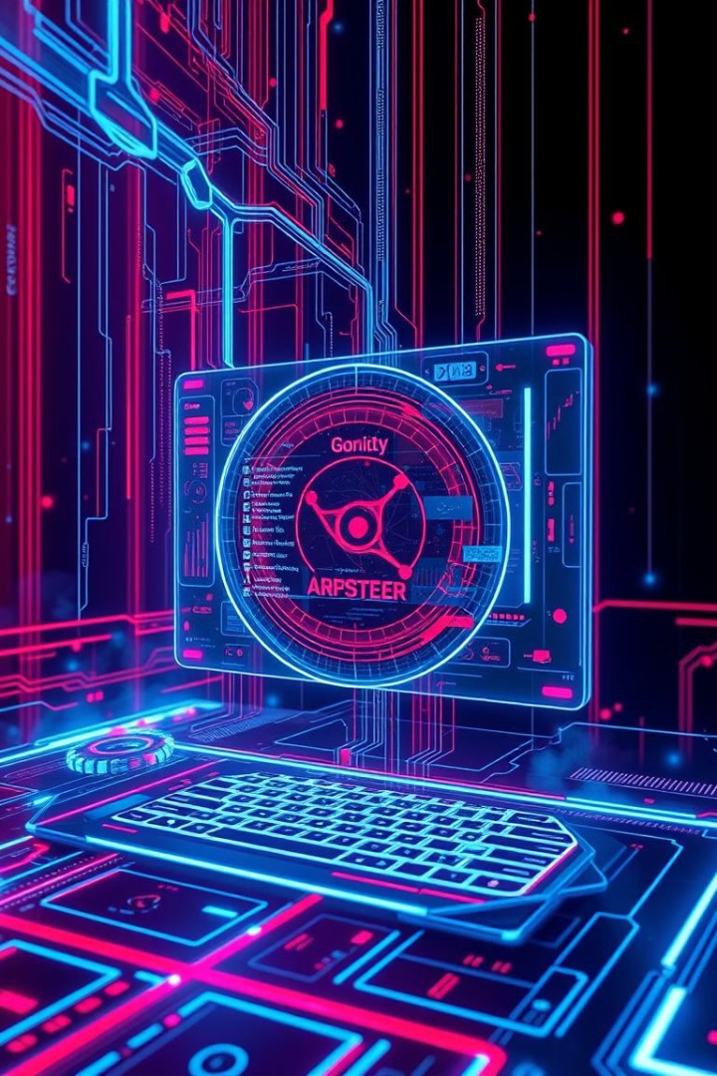

New Trends in Operating Systems
Exploring modern OS concepts, characteristics, roles, and challenges in the world of computer science.
by Holumbus

Slide 2

Introduction
Operating systems (OS) continuously evolve. They must meet modern computing demands.
New trends address scalability, mobility, and real-time performance.
Key topics include distributed, cloud, mobile, and multimedia OS.
1
Scalability
2
Mobility
Accommodate growing workloads.
Support handheld devices.
3
Real-time
Ensure timely processing.

Slide 3
Distributed Operating Systems
These systems manage multiple computers as one cohesive system.
They feature transparency for users and fault tolerance for reliability.
They also offer scalability for expanding resources.
Transparency
Fault Tolerance
Scalability
Unified system experience.
Continues despite failures.
Easily expands with nodes.

Slide 4




Cloud Operating Systems
Cloud OS manages virtualized resources via the internet.
Virtualization abstracts hardware for VMs and containers.
Elasticity scales resources dynamically, and costs are pay-per-use.
Virtualization
Abstracts hardware (VMs, containers).
Elasticity
Scales resources dynamically.
Pay-per-Use
Charges based on consumption.

Slide 5

Mobile Operating Systems
Optimized for handheld devices with touch interfaces and sensors.
Energy efficiency is prioritized to maximize battery life.
Mobile OS includes app sandboxing for enhanced security.
1
Energy Efficiency
Prioritizes battery life.
2
App Sandboxing
Enhances security.
3
Sensor Integration
Utilizes GPS, accelerometers.

Slide 6



Multimedia Operating Systems
Designed for real-time processing of audio and video.
Real-time scheduling ensures low-latency processing and high I/O throughput.
Codec support includes various multimedia formats.
High I/O Throughput
2
Handles large data streams.
Real-Time Scheduling
1
Ensures low-latency.
Codec Support
3
Supports multimedia formats.

Slide 7



Memory Wall and Bottlenecks
The performance gap exists between CPU and memory speeds.
CPUs advance faster than memory access speeds, increasing memory demand.
Solutions include caching and prefetching.
Caching
1
Hierarchical memory.
Prefetching
2
Anticipates data needs.
NUMA Architecture
3
Reduces latency.

Slide 8

Bottlenecks in Operating Systems
Common bottlenecks include Disk I/O, context switching, and security overhead.
Mitigation strategies involve parallelism and efficient algorithms.
Solutions include multi-core processing and better scheduling.
Disk I/O
Context Switching
Slow storage access.
Overhead from process switching.
Security Overhead
Encryption/decryption delays.

